Slide 1
Gabriel Galeote Checa
Project Flexible, Biocompatible, and Wirelessly Powered Implantable Optoelectronics | What I did last four weeks? Design final version of the circuit. Write Paper for IEEE Sensors Canada. Write Paper for IEEE Circ. Italy Write report. Prepare devices and automatize. production of the implants.
Problem being faced? Paper writing. Experiments. | What to do in next two weeks? Write Report. Prepare experimental data. Analyse the experimental data.

Slide 2
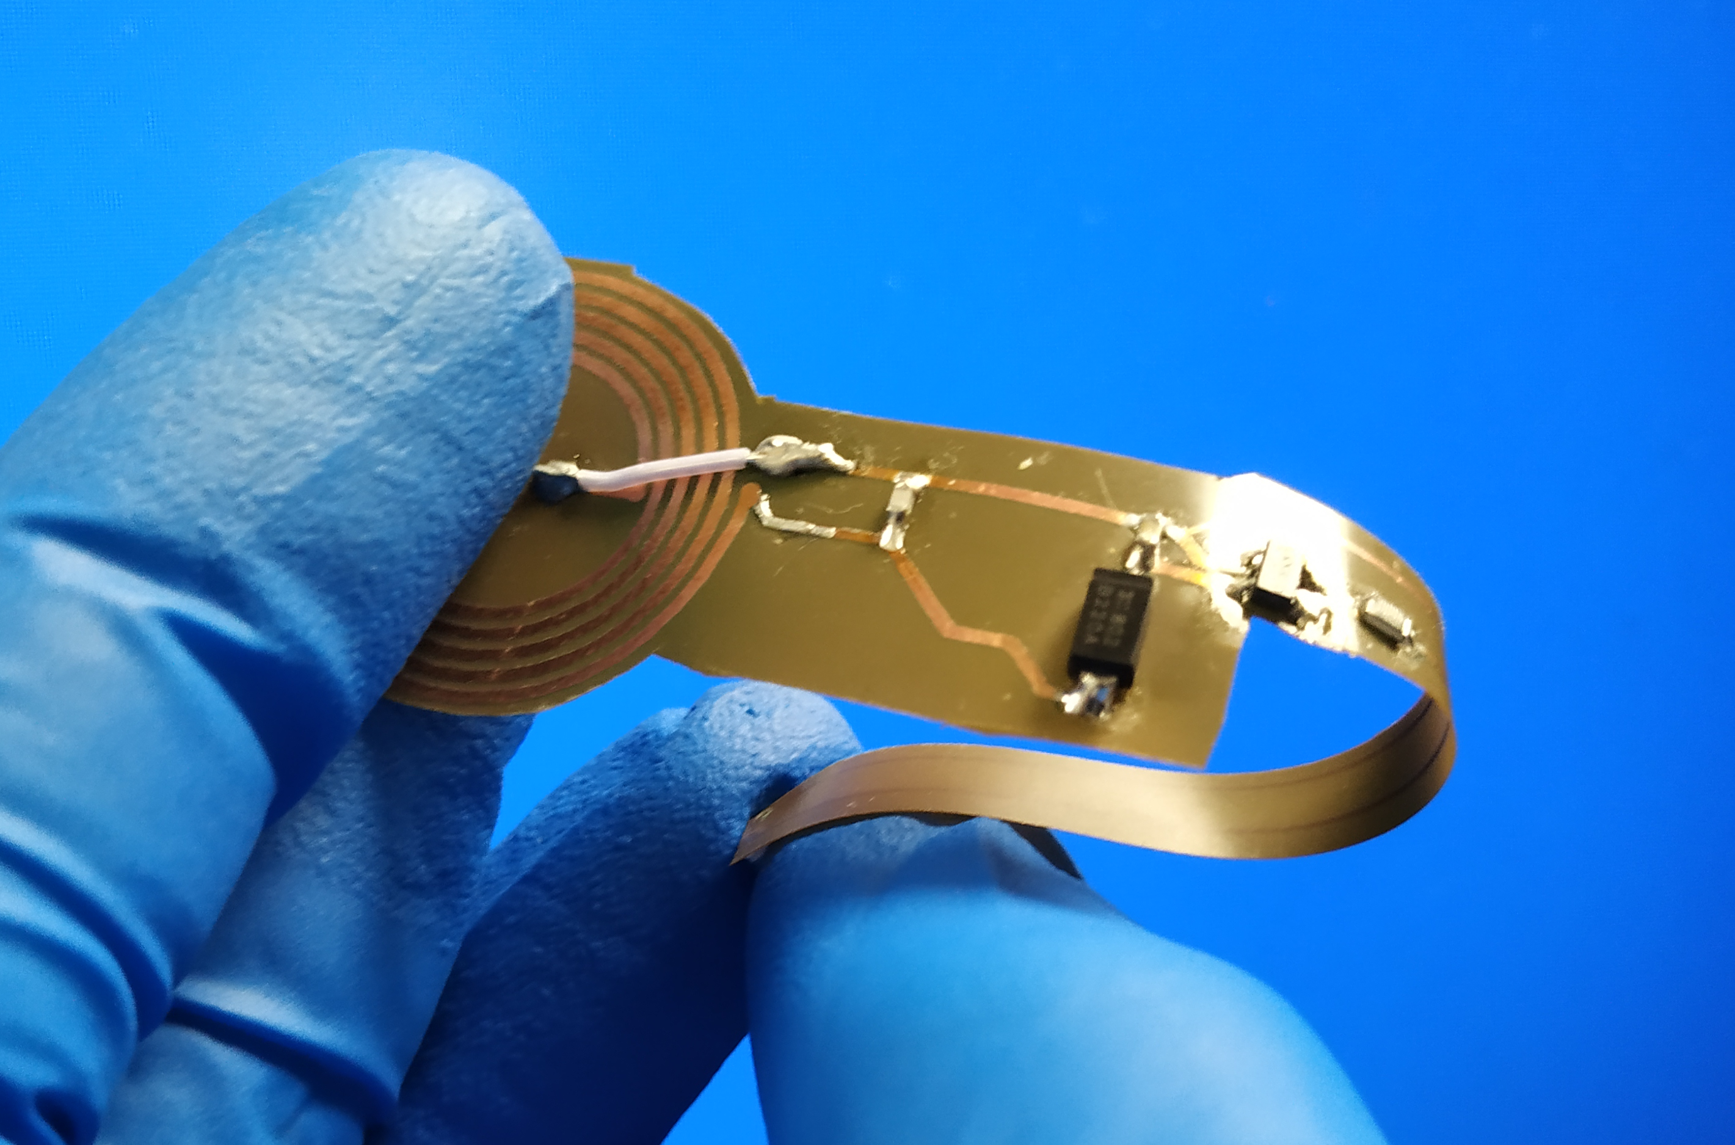
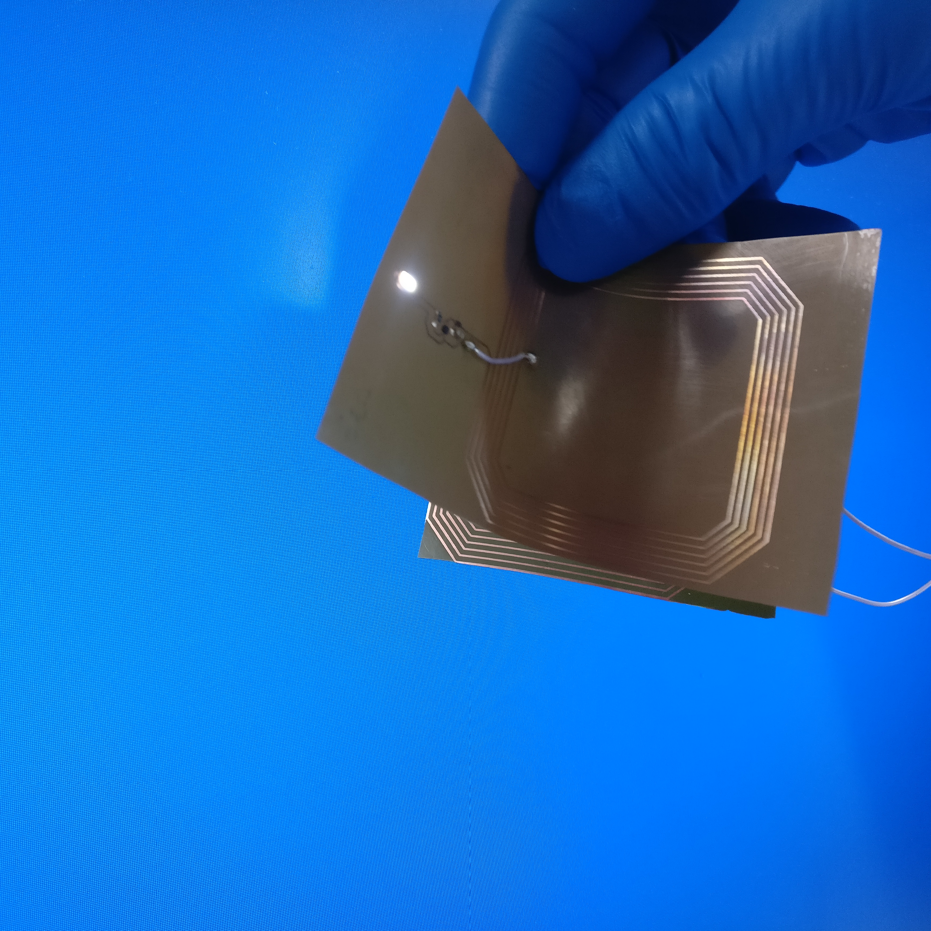
Bioimplantable Device
1. Current work
Final Version of the Circuit
Antenna tuned for 13.56 MHz
Antenna tuned for 8 MHz

Slide 3
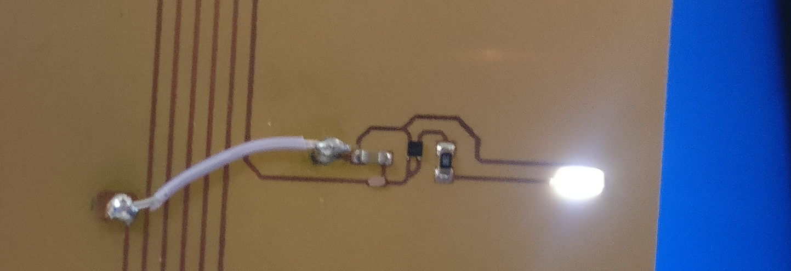
Bioimplantable Device
1. Current work
2cm
5mm

Slide 4
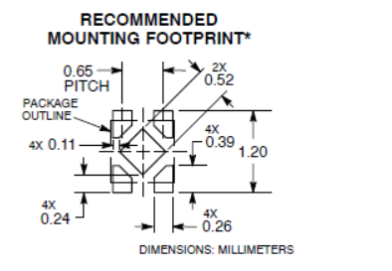

Bioimplantable Device
1. Current work
Main Considerations for Fabrication
Soldering technique using reflow oven: need for control of the especific ammount of solder paste

Slide 5
Bioimplantable Device
2. Fabrication Results Verification

Slide 6
Bioimplantable Device
2. Fabrication Results Verification
COPPER
POLYIMIDE
COPPER-POLYIMIDE BONDING

Slide 7
Bioimplantable Device
2. Fabrication Results Verification
Problems of the fabrication:
Bonding Copper-Polyimide very inestable
Copper strength decreases after reflow oven → It gets more rigid.
With a bigger size of the copper trace, greater stability.

Slide 8
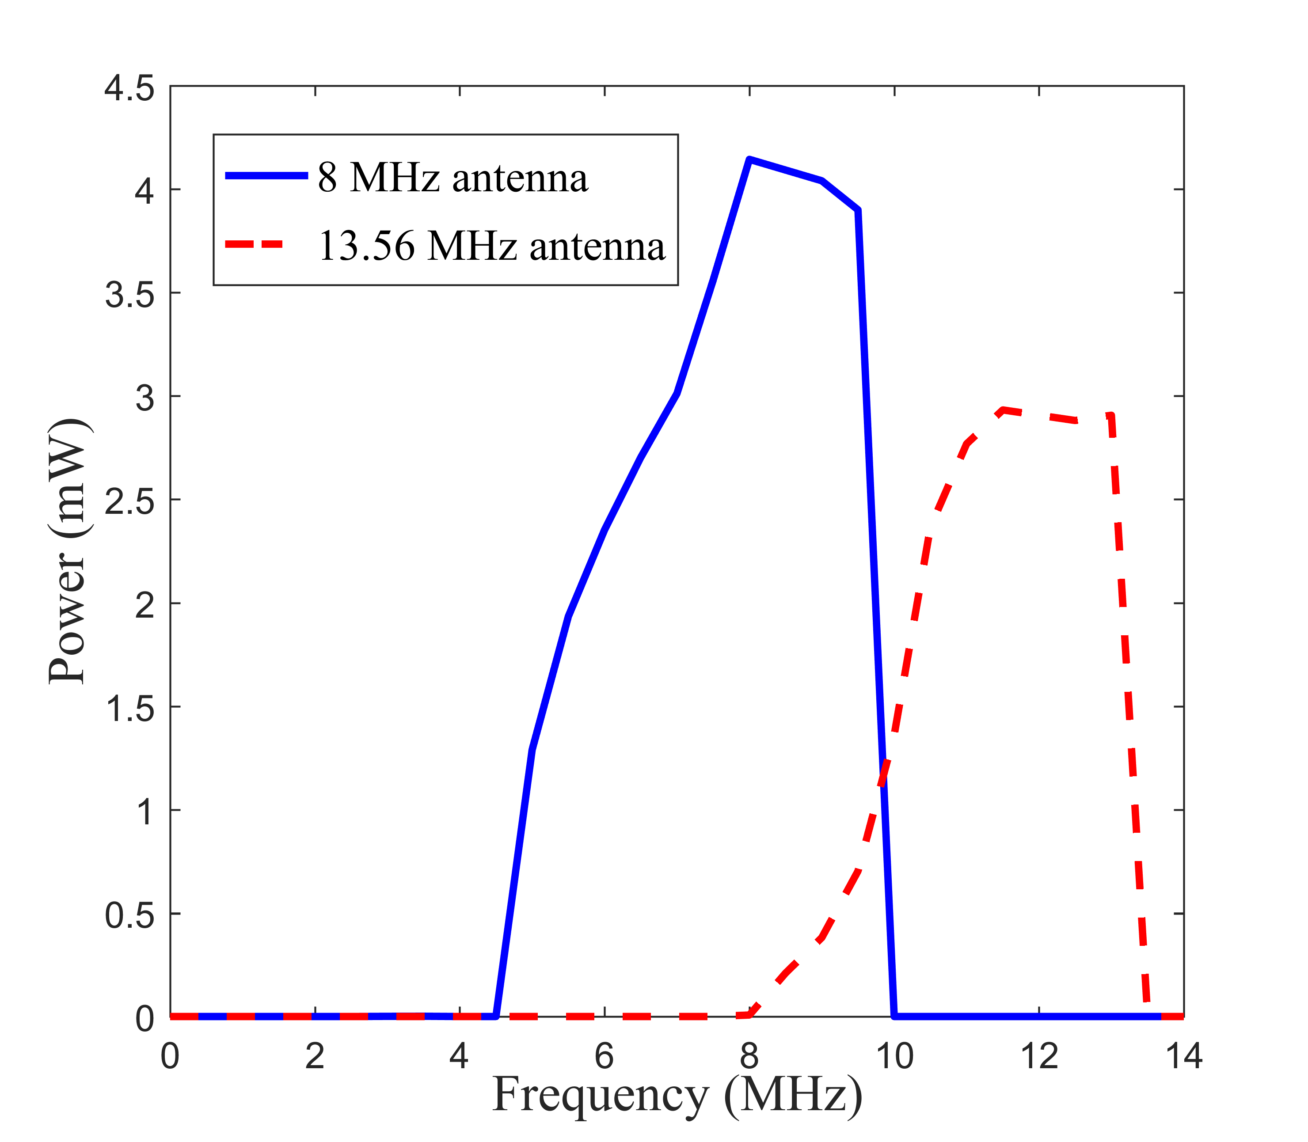
Bioimplantable Device
3. Experimental Results
This experimental results proofs:
The usefulness of the modular design giving us the option of changing the antena easily while keeping same electrical properties.
The correct operation of the Voltage regulator showin the stable voltaje within the bandwidth.
The limitation of the máximum power of the shank proving the effectivity of the voltaje regulator.
Test of the 8 MHz and 13.56 MHz.

Slide 9
Bioimplantable Device
3. Experimental Results

Slide 10
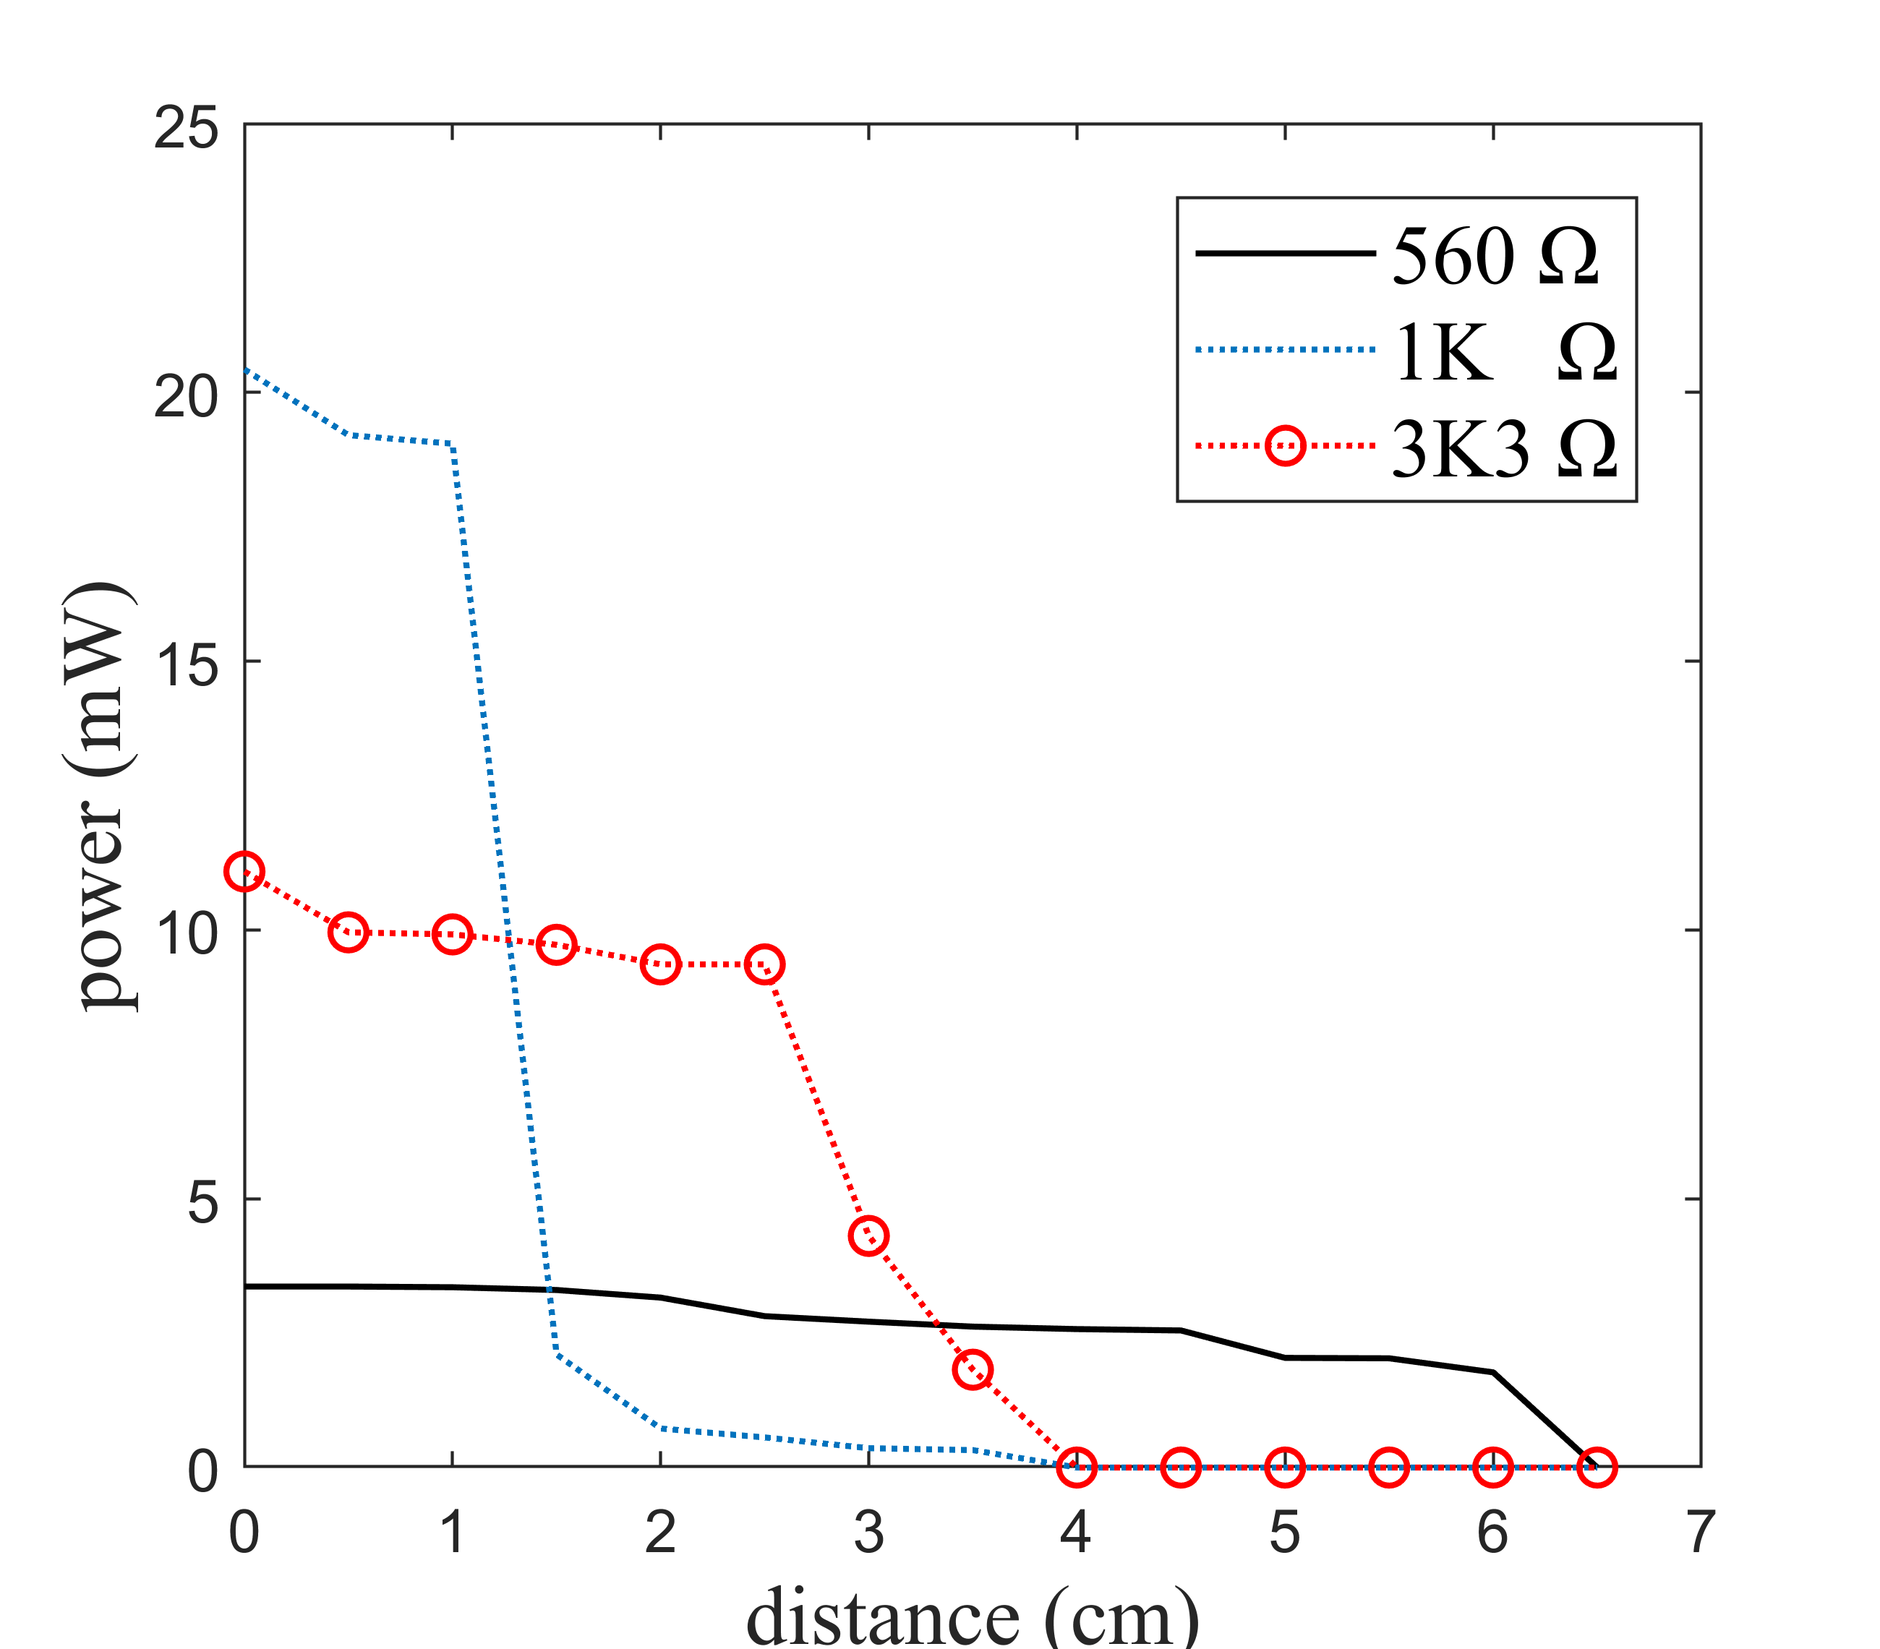
Bioimplantable Device
3. Experimental Results
The effect of the protection resistance for the LED:
Higher resistance, longer distance.
The operation of the LED in respect to the distance is not linear, PROOF of the Voltage Regulator effect on the circuit.

Slide 11
Bioimplantable Device
Further Steps
Finish IEEE Cir. And Elec. Syst.
Prepare Poster for MSc Thesis
Write MSc Thesis

Slide 12
Bioimplantable Device
Thank for the attention

